Slide 1
CPS216: Advanced Database Systems
Notes 07:Query Execution (Sort and Join operators)
Shivnath Babu

Slide 2
Query Processing - In class order
SQL query
parse
2; 16.1
parse tree
Query rewriting
3; 16.2,16.3
statistics
logical query plan
Physical plan generation
4; 16.4—16.7
physical query plan
execute
1; 13, 15
result

Slide 3
Roadmap
A simple operator: Nested Loop Join
Preliminaries
  Cost model
  Clustering
  Operator classes
Operator implementation (with examples from joins)
  Scan-based
  Sort-based
  Using existing indexes
  Hash-based
Buffer Management
Parallel Processing

Slide 4
Nested Loop Join (NLJ)
B | C
a | 10
a | 20
b | 10
d | 30
C | D
10 | cat
40 | dog
15 | bat
20 | rat
R1
R2
NLJ (conceptually)
for each r ∈ R1 do
for each s ∈ R2 do
if r.C = s.C then output r,s pair

Slide 5
Nested Loop Join (contd.)
Tuple-based
Block-based
Asymmetric

Slide 6
Implementing Operators
Basic algorithm
  Scan-based (e.g., NLJ)
  Sort-based
  Using existing indexes
  Hash-based (building an index on the fly)
Memory management
- Tradeoff between memory and #IOs
- Parallel processing

Slide 7
Roadmap
A simple operator: Nested Loop Join
Preliminaries
  Cost model
  Clustering
  Operator classes
Operator implementation (with examples from joins)
  Scan-based
  Sort-based
  Using existing indexes
  Hash-based
Buffer Management
Parallel Processing

Slide 8
Operator Cost Model
Simplest: Count # of disk blocks read and written during operator execution
Extends to query plans
  Cost of query plan = Sum of operator costs
Caution: Ignoring CPU costs

Slide 9
Assumptions
Single-processor-single-disk machine
  Will consider parallelism later
Ignore cost of writing out result
  Output size is independent of operator implementation
Ignore # accesses to index blocks

Slide 10
Parameters used in Cost Model
B(R) = # blocks storing R tuples
T(R) = # tuples in R
V(R,A) = # distinct values of attr A in R
M = # memory blocks available

Slide 11
Roadmap
A simple operator: Nested Loop Join
Preliminaries
  Cost model
  Clustering
  Operator classes
Operator implementation (with examples from joins)
  Scan-based
  Sort-based
  Using existing indexes
  Hash-based
Buffer Management
Parallel Processing

Slide 12
Notions of clustering
Clustered file organization
…..
Clustered relation
…..
Clustering index
R1 R2 S1 S2
R3 R4 S3 S4
R1 R2 R3 R4
R5 R5 R7 R8

Slide 13
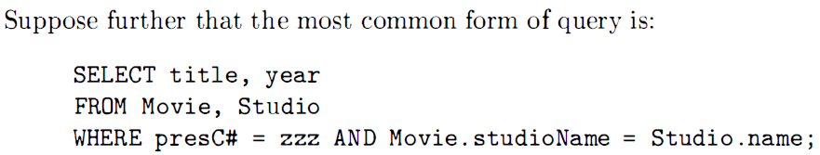
Notions of clustering

Slide 14
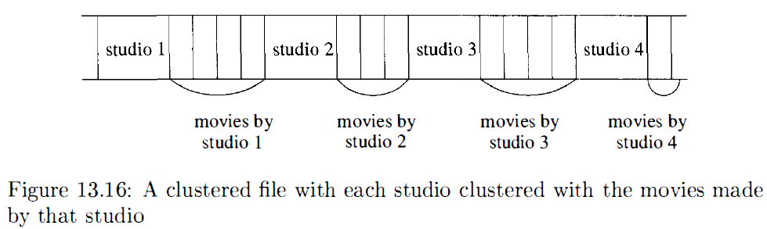
Notions of clustering

Slide 15
Clustering Index
Tuples with a given value of the search key packed in as few blocks as possible
10
10
35
A
index
19
19
19
19
42
37

Slide 16
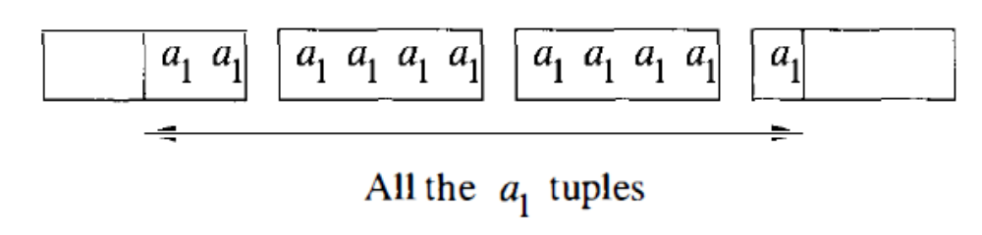
Clustering Index
An index on a is a clustering index,
Another index on b for the same relation is unlikely to be clustering

Slide 17
Example
T(R) = 10,000
B(R) = 200
If R is clustered, then # R tuples per block = 10,000/200 = 50
Let V(R,A) = 40
If I is a clustering index on R.A, then # IOs to access σ_{R.A = “a”}(R) = 200/40 = 5
If I is a non-clustering index on R.A, then # IOs to access σ_{R.A = “a”}(R) = 10000/40 = 250 ( > B(R))

Slide 18
Examples
T(R) = 10,000
B(R) = 200
If R is clustered, then # R tuples per block = 10,000/200 = 50
Let V(R,A) = 40
If I is a clustering index on R.A, then # IOs to access σ_{R.A = “a”}(R) = 250/50 = 5
If I is a non-clustering index on R.A, then # IOs to access σ_{R.A = “a”}(R) = 250 ( > B(R))

Slide 19
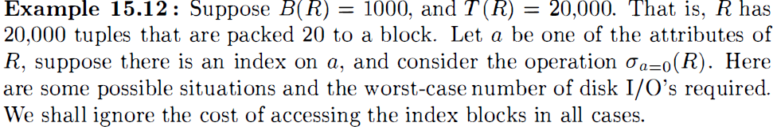
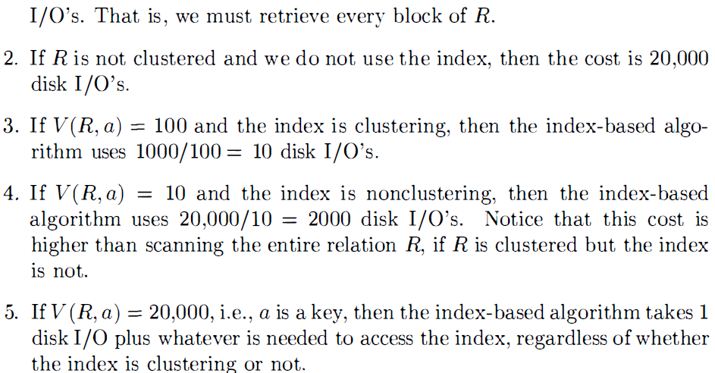

Slide 20
Operator Classes
 | Tuple-at-a-time | Full-relation
Unary | Select | Sort
Binary |  | Difference

Slide 21
Roadmap
A simple operator: Nested Loop Join
Preliminaries
  Cost model
  Clustering
  Operator classes
Operator implementation (with examples from joins)
  Scan-based
  Sort-based
  Using existing indexes
  Hash-based
Buffer Management
Parallel Processing

Slide 22
Implementing Tuple-at-a-time Operators
One pass algorithm:
  Scan
  Process tuples one by one
  Write output
Cost = B(R)
  Remember: Cost = # IOs, and we ignore the cost to write output

Slide 23
Implementing a Full-Relation Operator, Ex: Sort
Suppose T(R) x tupleSize(R) <= M x |B(R)|
Read R completely into memory
Sort
Write output
Cost = B(R)

Slide 25
Implementing a Full-Relation Operator, Ex: Sort
Suppose R won’t fit within M blocks
Consider a two-pass algorithm for Sort; generalizes to a multi-pass algorithm
Read R into memory in M-sized chunks
Sort each chunk in memory and write out to disk as a sorted sublist
Merge all sorted sublists
Write output

Slide 26
Two-phase Sort: Phase 1
Suppose B(R) = 1000, R is clustered, and M = 100
1
1
96
1
100
2
2
97
101
200
3
3
98
4
4
99
201
300
5
5
100
Memory
Sorted Sublists
999
801
900
1000
R
901
1000

Slide 27
Two-phase Sort: Phase 2
100
1
1
1
200
101
2
2
3
3
300
201
4
4
5
5
Sorted Sublists
6
7
8
900
801
9
999
10
1000
1000
901
Memory
Sorted R

Slide 28
Analysis of Two-Phase Sort
Cost = 3xB(R) if R is clustered,
= B(R) + 2B(R’) otherwise
Memory requirement M >= B(R)^{1/2}

Slide 29
Duplicate Elimination
Suppose B(R) <= M and R is clustered
Use an in-memory index structure
Cost = B(R)
Can we do with less memory?
  B(δ(R)) <= M
  Aggregation is similar to duplicate elimination

Slide 30
Duplicate Elimination Based on Sorting
Sort, then eliminate duplicates
Cost = Cost of sorting + B(R)
Can we reduce cost?
  Eliminate duplicates during the merge phase

Slide 31
Back to Nested Loop Join (NLJ)
B | C
a | 10
a | 20
b | 10
d | 30
C | D
10 | cat
40 | dog
15 | bat
20 | rat
R
S
NLJ (conceptually)
for each r ∈ R do
for each s ∈ S do
if r.C = s.C then output r,s pair

Slide 32
Analysis of Tuple-based NLJ
Cost with R as outer = T(R) + T(R) x T(S)
Cost with S as outer = T(S) + T(R) x T(S)
M >= 2

Slide 33
Block-based NLJ
Suppose R is outer
  Loop: Get the next M-1 R blocks into memory
  Join these with each block of S
B(R) + (B(R)/M-1) x B(S)
What if S is outer?
  B(S) + (B(S)/M-1) x B(R)

Slide 34
Let us work out an NLJ Example
Relations are not clustered
T(R1) = 10,000 T(R2) = 5,000
10 tuples/block for R1; and for R2
M = 101 blocks
Tuple-based NLJ Cost: for each R1 tuple:
[Read tuple + Read R2]
Total =10,000 [1+5000]=50,010,000 IOs

Slide 35
Can we do better when R,S are not clustered?
Use our memory
(1) Read 100 blocks worth of R1 tuples
(2) Read all of R2 (1 block at a time) + join
(3) Repeat until done

Slide 36
Cost: for each R1 chunk:
Read chunk: 1000 IOs
Read R2: 5000 IOs
Total/chunk = 6000
Total = 10,000 x 6000 = 60,000 IOs
1,000
[Vs. 50,010,000!]

Slide 37
Can we do better?
 Reverse join order: R2 R1
Total = 5000 x (1000 + 10,000) =
1000
5 x 11,000 = 55,000 IOs
[Vs. 60,000]

Slide 38
Example contd. NLJ R2 R1
Now suppose relations are clustered
Cost
For each R2 chunk:
Read chunk: 100 IOs
Read R1: 1000 IOs
Total/chunk = 1,100
Total= 5 chunks x 1,100 = 5,500 IOs
[Vs. 55,000]

Slide 39
Joins with Sorting
Sort-Merge Join (conceptually)
  (1) if R1 and R2 not sorted, sort them
  (2) i ← 1; j ← 1;
  While (i ≤ T(R1)) ∧ (j ≤ T(R2)) do
  if R1{ i }.C = R2{ j }.C then OutputTuples
  else if R1{ i }.C > R2{ j }.C then j ← j+1
  else if R1{ i }.C < R2{ j }.C then i ← i+1

Slide 40
Procedure Output-Tuples
While (R1{ i }.C = R2{ j }.C) ∧ (i ≤ T(R1)) do
[jj ← j;
while (R1{ i }.C = R2{ jj }.C) ∧ (jj ≤ T(R2)) do
[output pair R1{ i }, R2{ jj };
jj ← jj+1 ]
i ← i+1 ]

Slide 41
Example
i R1{i}.C R2{j}.C j
1 10 5 1
2 20 20 2
3 20 20 3
4 30 30 4
5 40 30 5
50 6
52 7

Slide 42
Block-based Sort-Merge Join
Block-based sort
Block-based merge

Slide 43
Two-phase Sort: Phase 1
Suppose B(R) = 1000 and M = 100
1
1
96
1
100
2
2
97
101
200
3
3
98
4
4
99
201
300
5
5
100
Memory
Sorted Sublists
999
801
900
1000
R
901
1000

Slide 44
Two-phase Sort: Phase 2
100
1
1
1
200
101
2
2
3
3
300
201
4
4
5
5
Sorted Sublists
6
7
8
900
801
9
999
10
1000
1000
901
Memory
Sorted R

Slide 45
Sort-Merge Join
R1
Sorted R1
Apply our merge algorithm
R2
Sorted R2
sorted sublists

Slide 46
Analysis of Sort-Merge Join
Cost = 5 x (B(R) + B(S))
Memory requirement:
M >= (max(B(R), B(S)))^{1/2}

Slide 47
Continuing with our Example
R1,R2 clustered, but unordered
Total cost = sort cost + join cost
= 6,000 + 1,500 = 7,500 IOs
But: NLJ cost = 5,500
So merge join does not pay off!

Slide 48
However …
NLJ cost = B(R) + B(R)B(S)/M-1 = O(B(R)B(S)) [Quadratic]
Sort-merge join cost = 5 x (B(R) + B(S)) = O(B(R) + B(S)) [Linear]

Slide 49
Can we Improve Sort-Merge Join?
R1
Sorted R1
Apply our merge algorithm
R2
Sorted R2
sorted sublists
Do we need to create the sorted R1, R2?

Slide 50
A more “Efficient” Sort-Merge Join
R1
Apply our merge algorithm
R2
sorted sublists

Slide 51
Analysis of the “Efficient” Sort-Merge Join
Cost = 3 x (B(R) + B(S))
[Vs. 5 x (B(R) + B(S))]
Memory requirement:
M >= (B(R) + B(S))^{1/2}
[Vs. M >= (max(B(R), B(S)))^{1/2}
Another catch with the more “Efficient” version: Higher chances of thrashing!

Slide 52
Cost of “Efficient” Sort-Merge join:
Cost = Read R1 + Write R1 into sublists
+ Read R2 + Write R2 into sublists + Read R1 and R2 sublists for Join
= 2000 + 1000 + 1500 = 4500
[Vs. 7500]

Slide 54
Memory requirements in our Example
B(R1) = 1000 blocks, 1000^{1/2} = 31.62
B(R2) = 500 blocks, 500^{1/2} = 22.36
B(R1) + B(R2) = 1500, 1500^{1/2} = 38.7
M > 32 buffers for simple sort-merge join
M > 39 buffers for efficient sort-merge join

Slide 55
Joins Using Existing Indexes
B | C
a | 10
a | 20
b | 10
d | 30
Index I on S.C
C | D
10 | cat
40 | dog
15 | bat
20 | rat
R
S
Indexed NLJ (conceptually)
for each r ∈ R do
for each s ∈ S that matches probe(I,r.C) do
output r,s pair

Slide 56
Continuing with our Running Example
Assume R1.C index exists; 2 levels
Assume R2 clustered, unordered
Assume R1.C index fits in memory

Slide 57
Cost: R2 Reads: 500 IOs
for each R2 tuple:
- probe index - free
- if match, read R1 tuple
# R1 Reads depends on:
- # matching tuples
- clustering index or not

Slide 58
What is expected # of matching tuples?
(a) say R1.C is key, R2.C is foreign key
then expected = 1 tuple
(b) say V(R1,C) = 5000, T(R1) = 10,000
with uniform assumption
expect = 10,000/5,000 = 2

Slide 59
What is expected # of matching tuples?
(c) Say DOM(R1, C) = 1,000,000
T(R1) = 10,000
with assumption of uniform distribution in domain
Expected = 10,000 = 1 tuples
1,000,000 100

Slide 60
Total cost with Index Join with a Non-Clustering Index
(a) Total cost = 500+5000(1) = 5,500
(b) Total cost = 500+5000(2) = 10,500
(c) Total cost = 500+5000(1/100) = 550
Will any of these change if we have a clustering index?

Slide 61
What if index does not fit in memory?
Example: say R1.C index is 201 blocks
Keep root + 99 leaf nodes in memory
Expected cost of each index access is
E = (0)99 + (1)101 ≈ 0.5
200 200

Slide 62
Total cost (including Index Probes)
= 500+5000 [Probe + Get Records]
= 500+5000 [0.5+2]
= 500+12,500 = 13,000 (Case b)
For Case (c):
= 500+5000[0.5 × 1 + (1/100) × 1]
= 500+2500+50 = 3050 IOs

Slide 63
Joining by Using an Index
R is clustered, we shall have to read B(R) blocks to get all the tuples of R.
If R is not clustered, then up to T (R) disk I/O 's may be required.
For each tuple t of R we must read an average of T(S) /V(S, Y) tuples of S.
If S has a nonclustered index on Y , then the number of disk I/ 0 's required to read S is T(R)T(S) /V(S, Y)
If the index is clustered, then only T (R)B(S) /V (S, Y) disk I/O's suffice

Slide 64
Joining by Using an Index
Example 15.13 : Let us consider our running example, relations R(X, Y) and S(Y, Z) covering 1000 and 500 blocks , respectively. Assume ten tuples of either relation fit on one block, so T(R) = 10,000 and T(S) = 5000. Also, assume V(S, Y) = 100; i.e. , there are 100 different values of Y among the tuples of S.
Suppose that R is clustered, and there is a clustering index on Y for S.
Then the approximate number of disk I/O 's, excluding what is needed to access the index itself, is 1000 to read the blocks of R and plus 10,000 x 500 / 100 = 50,000 disk I/O 's.

Slide 65
Joins Using a Sorted Index
Example 15.14 : Suppose that we have relations R(X, Y) and S(Y, Z) with indexes on Y for both relations . In a tiny example, let the search keys (Yvalues) for the tuples of R be in order 1, 3, 4, 4, 4, 5, 6, and let the search key values for S be 2, 2 , 4, 4, 6, 7.

Slide 66
Joins Using a Sorted Index
Example 15.15 : Let us continue with Example 15.13, first, assume that there is an index on Y for S that allows us to retrieve the tuples of S sorted by Y.
Both relations and the index are clustered.
There is no index on R. 101 Memory Blocks.
Create 10 sorted sublists for the 1000-block relation R.
The number of disk I/O's is 2000 to read and write all of R
We next use 11 blocks of memory - 10 for the sublists of R and one for a block of S's tuples, retrieved via the index
In second pass, we read all the tuples of R and S, using a total of 1500 disk I/O ‘s
We thus estimate the total number of disk I/O's at 3500

Slide 67
Joins Using a Sorted Index
Now, assume that both R and S have indexes on Y.
No need to sort either relation.
Just 1500 disk I/O's to read the blocks of R and S through their indexes.
In fact, if we determine from the indexes alone that a large fraction of R or S cannot match tuples of the other relation, then the total cost could be considerably less than 1500 disk I/O's.

Slide 68
So far
NLJ R2 R1 55,000 (best)
Merge Join _______
Sort+ Merge Join _______
R1.C Index _______
R2.C Index _______
NLJ R2 R1 5500
Merge join 1500
Sort+Merge Join 7500 → 4500
R1.C Index 5500, 3050, 550
R2.C Index ________
not clustered
clustered

Slide 69
Building Indexes on the fly for Joins
Hash join (conceptual)
  Hash function h, range 1 → k
  Buckets for R1: G1, G2, ... Gk
  Buckets for R2: H1, H2, ... Hk
Algorithm
(1) Hash R1 tuples into G1--Gk
(2) Hash R2 tuples into H1--Hk
(3) For i = 1 to k do
Match tuples in Gi, Hi buckets

Slide 70
Example Continued: Hash Join
R1, R2 contiguous
→ Use 100 buckets
→ Read R1, hash, + write buckets
R1 →
100
...
...
10 blocks

Slide 71
-> Same for R2
-> Read one R1 bucket; build memory hash table
[R1 is called the build relation of the hash join]
-> Read corresponding R2 bucket + hash probe
[R2 is called the probe relation of the hash join]
R1
R2
R1
...
...
Memory
Then repeat for all buckets

Slide 72
Hash-Join
Original
Relation
OUTPUT
Partitions
1
Partition both relations using hash fn h1: R tuples in partition i will only match S tuples in partition i.
(if partition is bigger than B-2, do it again)
1
INPUT
2
hash
function
h1
2
. . .
B-1
B-1
Disk
B main memory buffers
Disk
Partitions
of R & S
Join Result
Read in a partition of R, hash it using h2. Scan matching partition of S, search for matches.
Hash table for partition
Ri (k < B-1 pages)
hash
fn
h2
h2
Input buffer
for Si
Output
buffer
Disk
B main memory buffers
Disk
Notes:
14

Slide 73
Cost:
“Bucketize:” Read R1 + write
Read R2 + write
Join: Read R1, R2
Total cost = 3 x [1000+500] = 4500

Slide 74
Minimum Memory Requirements
Size of R1 bucket = (x/k)
k = number of buckets (k = M-1)
x = number of R1 blocks
So... (x/k) <= k ➔ k >= √x ➔ M > √x
Actually, M > √min(B(R),B(S))
[Vs. M > √B(R)+B(S) for Sort-Merge Join]

Slide 75
Trick: keep some buckets in memory
E.g., k’=33 R1 buckets = 31 blocks
keep 2 in memory
memory
Memory use:
G0 31 buffers
G1 31 buffers
Output 33-2 buffers
R1 input 1
Total 94 buffers
6 buffers to spare!!
G0
in
R1
31
G1
33-2=31
...
called Hybrid Hash-Join

Slide 76
Trick: keep some buckets in memory
E.g., k’=33 R1 buckets = 31 blocks
keep 2 buckets in memory
memory
Memory use:
G0 31 buffers
G1 31 buffers
Output 33-2 buffers
R1 input 1
Total 94 buffers
6 buffers to spare!!
in
G0
R1
31
G1
31 Buckets, one block each
33-2=31
...
called hybrid hash-join
CS 245
Notes 7

Slide 77
Next: Bucketize R2
  R2 buckets =500/33= 16 blocks
  Two of the R2 buckets joined immediately with G0,G1
memory
R2 buckets
R1 buckets
in
G0
R2
16
31
G1
31 Buckets, one block each
33-2=31
33-2=31
...
...
CS 245
Notes 7

Slide 78
Next: Bucketize R2
  R2 buckets =500/33= 16 blocks
  Two of the R2 buckets joined immediately with G0,G1
memory
R2 buckets
R1 buckets
G0
in
16
31
R2
G1
33-2=31
33-2=31
...
...

Slide 79
Finally: Join remaining buckets
  for each bucket pair:
    read one of the buckets into memory
    join with second bucket
memory
one full R2
bucket
R2 buckets
R1 buckets
out
ans
Hi
16
31
one R1
buffer
33-2=31
33-2=31
...
...

Slide 80
Cost
Bucketize R1 = 1000+31×31=1961
To bucketize R2, only write 31 buckets: so, cost = 500+31×16=996
To compare join (2 buckets already done) read 31×31+31×16=1457
Total cost = 1961+996+1457 = 4414

Slide 82
Hybrid Hash-Join
Example 15.10 : Consider the problem of Example 15.4, where we had to join relations R and S, of 1000 and 500 blocks, respectively, using M = 101. If we use a hybrid hash-join, then we want k, the number of buckets, to be about 500/ 101. Suppose we pick k = 5 .
Then the average bucket will have 100 blocks of S's tuples. If we try to fit one of these buckets and four extra blocks for the other four buckets, we need 104 blocks of main memory

Slide 83
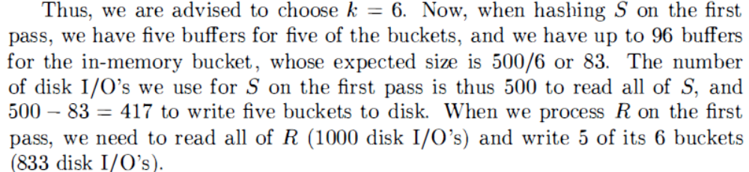
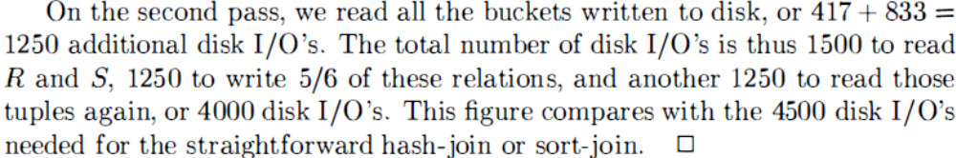
Hybrid Hash-Join

Slide 84
Another hash join trick:
Only write into buckets <val,ptr> pairs
When we get a match in join phase, must fetch tuples
CS 245
Notes 7

Slide 85
To illustrate cost computation, assume:
  100 <val,ptr> pairs/block
  expected number of result tuples is 100
CS 245
Notes 7

Slide 86
To illustrate cost computation, assume:
  100 <val,ptr> pairs/block
  expected number of result tuples is 100
Build hash table for R2 in memory 5000 tuples → 5000/100 = 50 blocks
Read R1 and match
Read ~ 100 R2 tuples
CS 245
Notes 7

Slide 87
To illustrate cost computation, assume:
  100 <val,ptr> pairs/block
  expected number of result tuples is 100
Build hash table for R2 in memory 5000 tuples → 5000/100 = 50 blocks
Read R1 and match
Read ~ 100 R2 tuples
Total cost = Read R2: 500
Read R1: 1000
Get tuples: 100
1600
CS 245
Notes 7

Slide 88
To illustrate cost computation, assume:
  100 <val,ptr> pairs/block
  expected number of result tuples is 100
Build hash table for R2 in memory 5000 tuples → 5000/100 = 50 blocks
Read R1 and match
Read ~ 100 R2 tuples
Total cost = Read R2: 500
Read R1: 1000
Get tuples: 100
1600

Slide 89
So far:
NLJ 5500
Merge join 1500
Sort+merge joint 7500
R1.C index 5500 → 550
R2.C index _____
Build R.C index _____
Build S.C index _____
Hash join 4500
with trick,R1 first 4414
with trick,R2 first _____
Hash join, pointers 1600
clustered

Slide 90
Hash-based Vs. Sort-based Joins
Some similarities (see textbook), some dissimilarities
Non-equi joins
Memory requirement
Sort order may be useful later

Slide 91
Summary
NLJ ok for “small” relations (relative to memory size)
For equi-join, where relations not sorted and no indexes exist, Hybrid Hash Join usually best

Slide 92
Summary (contd.)
Sort-Merge Join good for non-equi-join (e.g., R1.C > R2.C)
If relations already sorted, use Merge Join
If index exists, it could be useful
  Depends on expected result size and index clustering
Join techniques apply to Union, Intersection, Difference

Slide 93
Buffer Management
DBMS Buffer Manager
May control memory directly (i.e., does not allocate from virtual memory controlled by OS)
Read/write
Buffer Manager
Block read/write

Slide 94
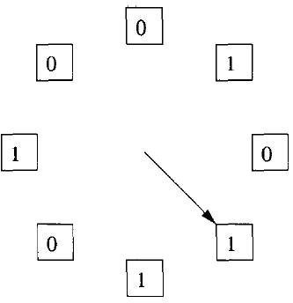
Buffer Replacement Policies
Least Recently Used (LRU)
Second-chance
Most Recently Used (MRU)
FIFO

Slide 95
Interaction between Operators and Buffer Management
Memory (our M parameter) may change while an operator is running
Some operators can take advantage of specific buffer replacement policies
  E.g., Rocking in Block-based NLJ
FIFO requires less maintenance than LRU, but it can make more mistakes.
A block that is used repeatedly, root block of a B-tree index, will eventually become the oldest block in a buffer.

Slide 96
Join Strategies for Parallel Processors
May cover later if time permits
We will see one example: Hash Join
R1
R2
R1
...
...
Memory
R2’s Hash partitions
R1’s Hash partitions

Slide 97
Textbook Material
All of Chapter 15 except 15.8
  15.8 covers multi-pass sort and hash

Slide 98
Roadmap
A simple operator: Nested Loop Join
Preliminaries
  Cost model
  Clustering
  Operator classes
Operator implementation (with examples from joins)
  Scan-based
  Sort-based
  Using existing indexes
  Hash-based
Buffer Management
Parallel Processing

